Slide 1
Cryptography and Network Security
Third Edition
by William Stallings
Lecture slides by Lawrie Brown

Slide 2
Chapter 15 – Electronic Mail Security
Despite the refusal of VADM Poindexter and LtCol North to appear, the Board's access to other sources of information filled much of this gap. The FBI provided documents taken from the files of the National Security Advisor and relevant NSC staff members, including messages from the PROF system between VADM Poindexter and LtCol North. The PROF messages were conversations by computer, written at the time events occurred and presumed by the writers to be protected from disclosure. In this sense, they provide a first-hand, contemporaneous account of events.
—The Tower Commission Report to President Reagan on the Iran-Contra Affair, 1987

Slide 3
Email Security
email is one of the most widely used and regarded network services
currently message contents are not secure
  may be inspected either in transit
  or by suitably privileged users on destination system
Notes:
Current email services are roughly like "postcards". Anyone who wants could pick it up and have a look as its in transit or sitting in the recipients mailbox.

Slide 4
Email Security Enhancements
confidentiality
  protection from disclosure
authentication
  of sender of message
message integrity
  protection from modification
non-repudiation of origin
  protection from denial by sender
Notes:
What we want is something more akin to standard mail (contents protected inside an envelope) if not registered mail (have confidence about the sender of the mail and its contents).

Slide 5
Pretty Good Privacy (PGP)
widely used de facto secure email
developed by Phil Zimmermann
selected best available crypto algs to use
integrated into a single program
available on Unix, PC, Macintosh and Amiga systems
originally free, now have commercial versions available also

Slide 6
PGP Operation – Authentication
sender creates a message
SHA-1 used to generate 160-bit hash code of message
hash code is encrypted with RSA using the sender's private key, and result is attached to message
receiver uses RSA or DSS with sender's public key to decrypt and recover hash code
receiver generates new hash code for message and compares with decrypted hash code, if match, message is accepted as authentic

Slide 7
PGP Operation – Confidentiality
sender generates message and random 128-bit number to be used as session key for this message only
message is encrypted, using CAST-128 / IDEA/3DES with session key
session key is encrypted using RSA with recipient's public key, then attached to message
receiver uses RSA with its private key to decrypt and recover session key
session key is used to decrypt message

Slide 8
PGP Operation – Confidentiality & Authentication
uses both services on same message
  create signature & attach to message
  encrypt both message & signature
  attach RSA encrypted session key

Slide 9
PGP Operation – Compression
by default PGP compresses message after signing but before encrypting
  so can store uncompressed message & signature for later verification
  & because compression is non deterministic
uses ZIP compression algorithm

Slide 10
PGP Operation – Email Compatibility
when using PGP will have binary data to send (encrypted message etc)
however email was designed only for text
hence PGP must encode raw binary data into printable ASCII characters
uses radix-64 algorithm
  maps 3 bytes to 4 printable chars
  also appends a CRC
PGP also segments messages if too big

Slide 11
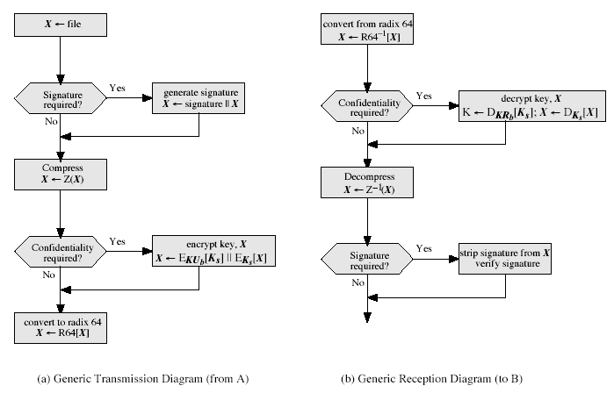
PGP Operation – Summary
Notes:
Stallings Fig 15-2.

Slide 12
PGP Session Keys
need a session key for each message
  of varying sizes: 56-bit DES, 128-bit CAST or IDEA, 168-bit Triple-DES
generated using ANSI X12.17 mode
uses random inputs taken from previous uses and from keystroke timing of user

Slide 13
PGP Public & Private Keys
since many public/private keys may be in use, need to identify which is actually used to encrypt session key in a message
  could send full public-key with every message
  but this is inefficient
rather use a key identifier based on key
  is least significant 64-bits of the key
  will very likely be unique
also use key ID in signatures

Slide 14
PGP Key Rings
each PGP user has a pair of keyrings:
  public-key ring contains all the public-keys of other PGP users known to this user, indexed by key ID
  private-key ring contains the public/private key pair(s) for this user, indexed by key ID & encrypted keyed from a hashed passphrase

Slide 15
PGP Key Management
rather than relying on certificate authorities
in PGP every user is own CA
  can sign keys for users they know directly
forms a “web of trust”
  trust keys have signed
  can trust keys others have signed if have a chain of signatures to them
key ring includes trust indicators
users can also revoke their keys

Slide 16
S/MIME (Secure/Multipurpose Internet Mail Extensions)
security enhancement to MIME email
  original Internet RFC822 email was text only
  MIME provided support for varying content types and multi-part messages
  with encoding of binary data to textual form
  S/MIME added security enhancements
have S/MIME support in various modern mail agents: MS Outlook, Netscape etc

Slide 17
S/MIME Functions
enveloped data
  encrypted content and associated keys
signed data
  encoded message + signed digest
clear-signed data
  cleartext message + encoded signed digest
signed & enveloped data
  nesting of signed & encrypted entities

Slide 18
S/MIME Cryptographic Algorithms
hash functions: SHA-1 & MD5
digital signatures: DSS & RSA
session key encryption: ElGamal & RSA
message encryption: Triple-DES, RC2/40 and others
have a procedure to decide which algorithms to use

Slide 19
S/MIME Certificate Processing
S/MIME uses X.509 v3 certificates
managed using a hybrid of a strict X.509 CA hierarchy & PGP’s web of trust
each client has a list of trusted CA’s certs
and own public/private key pairs & certs
certificates must be signed by trusted CA’s

Slide 20
Certificate Authorities
have several well-known CA’s
Verisign one of most widely used
Verisign issues several types of Digital IDs
with increasing levels of checks & hence trust
  Class Identity Checks Usage
  1 name/email check web browsing/email
  2+ enroll/addr check email, subs, s/w validate
  3+ ID documents e-banking/service access

Slide 21
Summary
have considered:
  secure email
  PGP
  S/MIME

